Slide 2
We want to make volunteering with Scouts easier and more fun…
…so that we can attract more volunteers and our current volunteers want to stay

Slide 3
We need to adapt to stay relevant, attract new volunteers, and make sure the scouts is enjoyable for everyone.

Slide 6
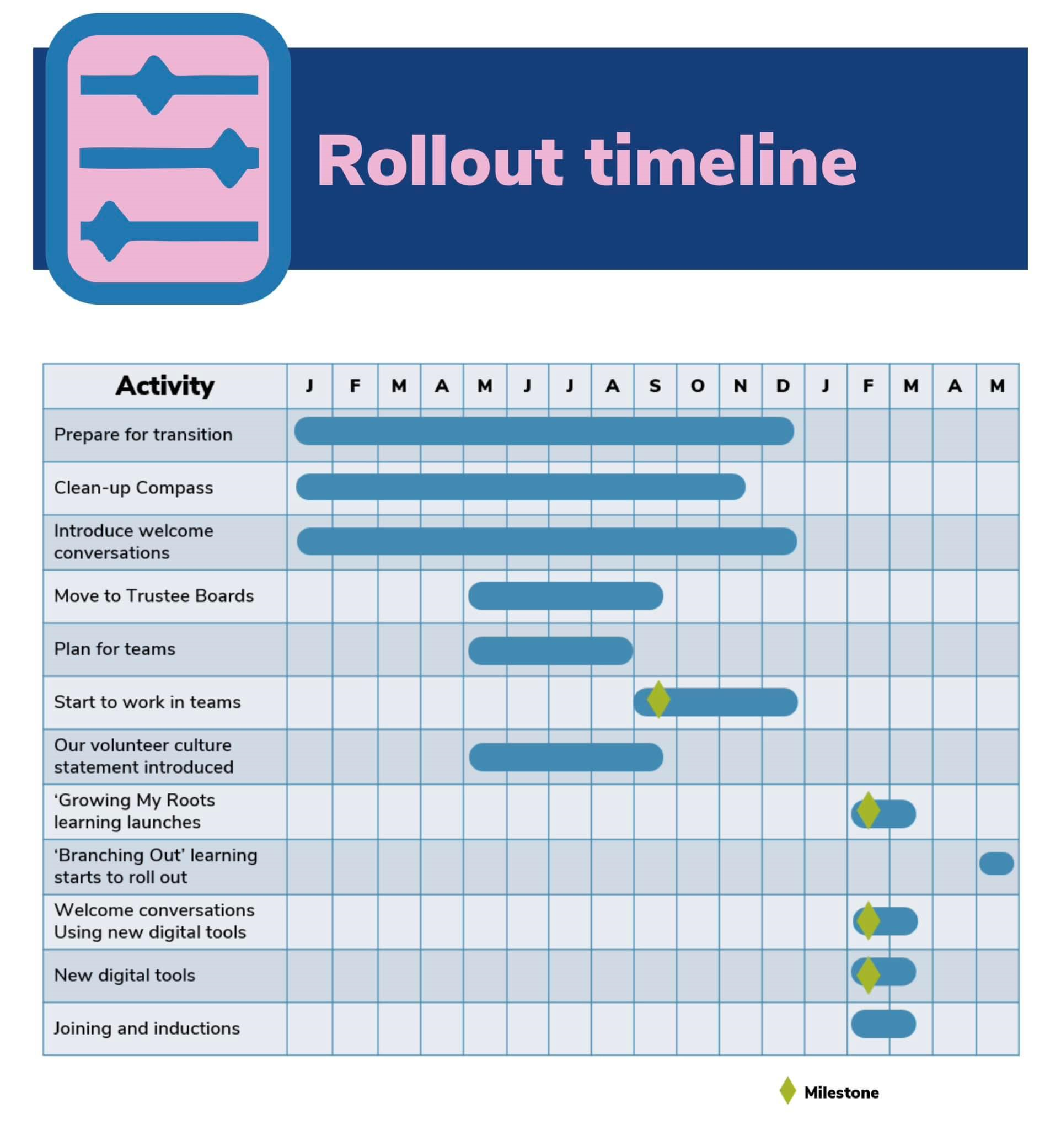

Slide 7
Moving from training
to
learning

Slide 8
This session looks at:
Why we need to improve how we learn
What learning will look like
Putting it all together and making it happen…
How we will transition from training to learning

Slide 9
Current training
Externally well regarded for its breadth and content
Volunteers value the Wood Badge when they achieve it
Internally difficult to navigate the training scheme syllabus

Slide 10
Current training
Modules are not always specific to a role and are often duplicated when changing roles
Volunteers are put off by having to repeat training or validation when moving role
Reliance on having many dedicated volunteers to:
Update PLPs & Compass
Deliver & validate training
Manage on-going learning

Slide 11
Why we need to improve how we learn
National research showed very clearly that most volunteers don’t find the current training scheme lives up to what they need and is not meeting the needs and requirements of our ever-changing Scout Movement

Slide 12
More relevant and engaging learning
From | To
"Training" and Training teams Time-consuming to do & validate Hard work to track and manage Off-putting digital experience Wood badge for almost every role | Personalised learning when you need it, tailored to your role Support and management of learning built into our structures Existing skills recognised and sign off built in, no separate validation Easy to manage and report compliance Digital first (but not digital only), bite-sized, in one place Wood badge optional and available to all

Slide 13
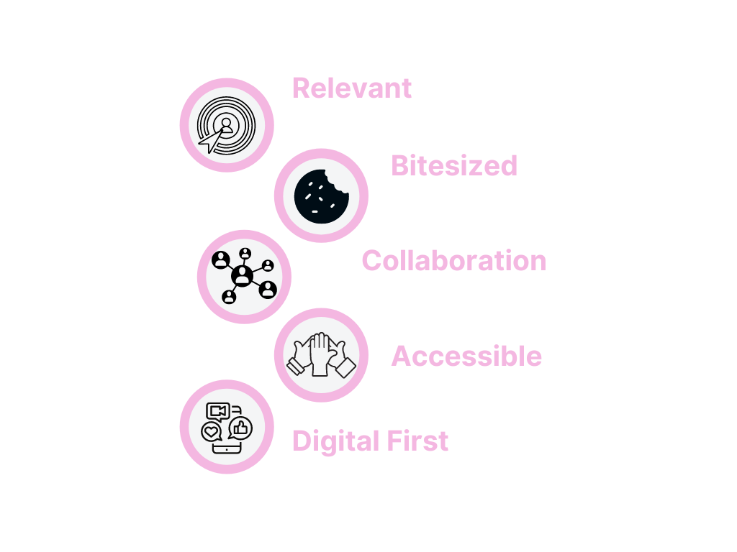

Slide 14
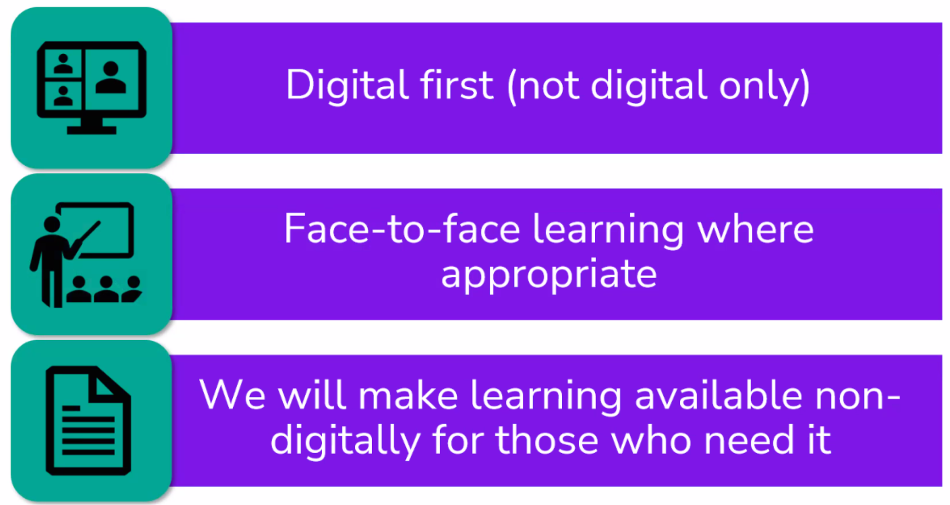

Slide 15
The impact on you
The new way of working will affect:
everyone who hasn’t yet completed all of the modules relevant to their role
everyone’s ongoing learning requirements
all adults who haven’t yet completed their Wood Badge
all new volunteers

Slide 16
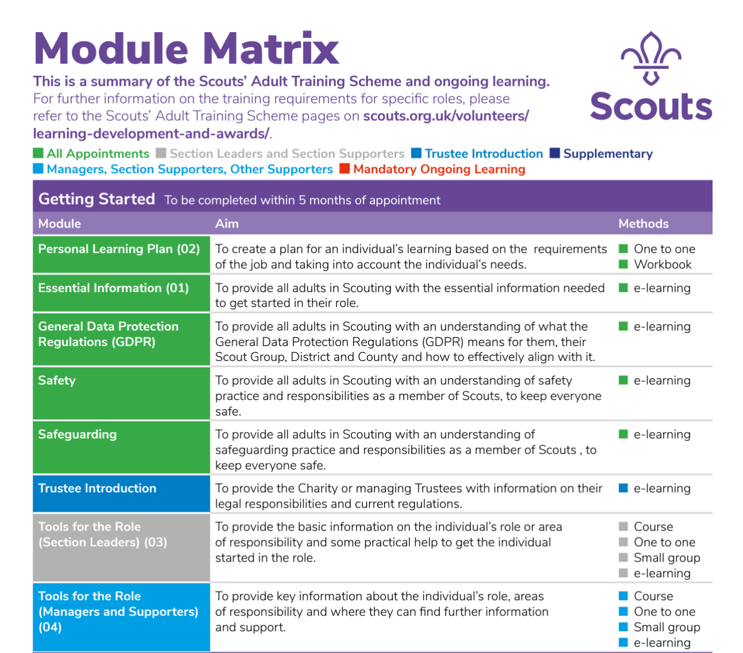
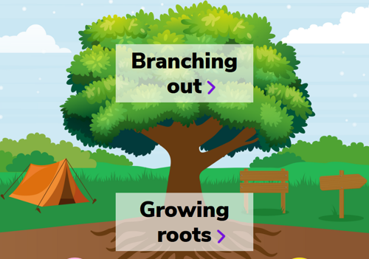
Moving from training to learning

Slide 17
Branching
Out
(optional learning)
Growing my roots
(mandatory for all adults)

Slide 18
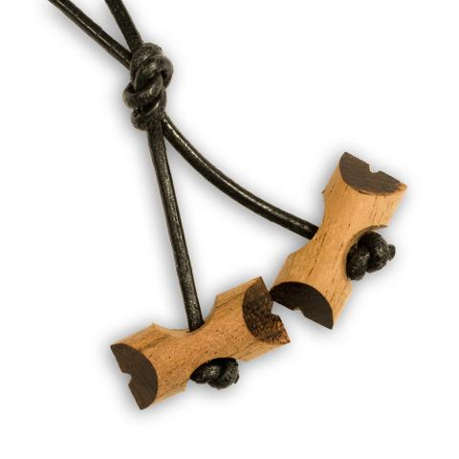
Branching
Out
(optional learning)
Wood
Badge
Growing my roots
(mandatory for all adults)

Slide 19
Growing Roots
(Mandatory Learning)

Slide 20
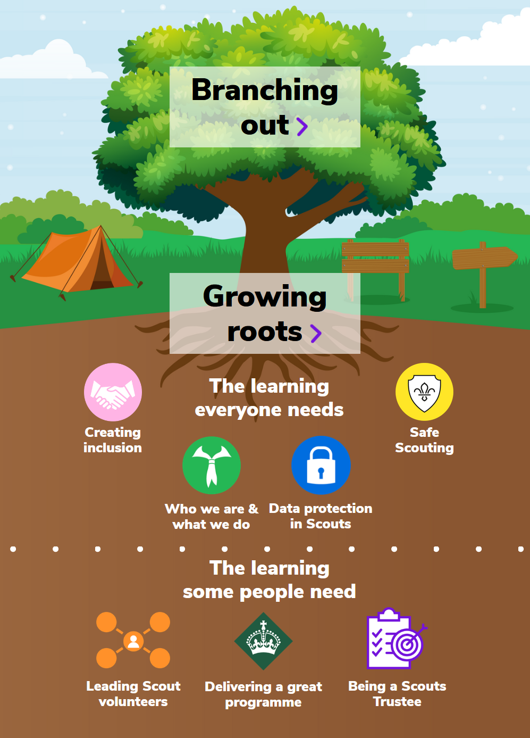

Slide 23
Modules that will be retired in 2024

Slide 24
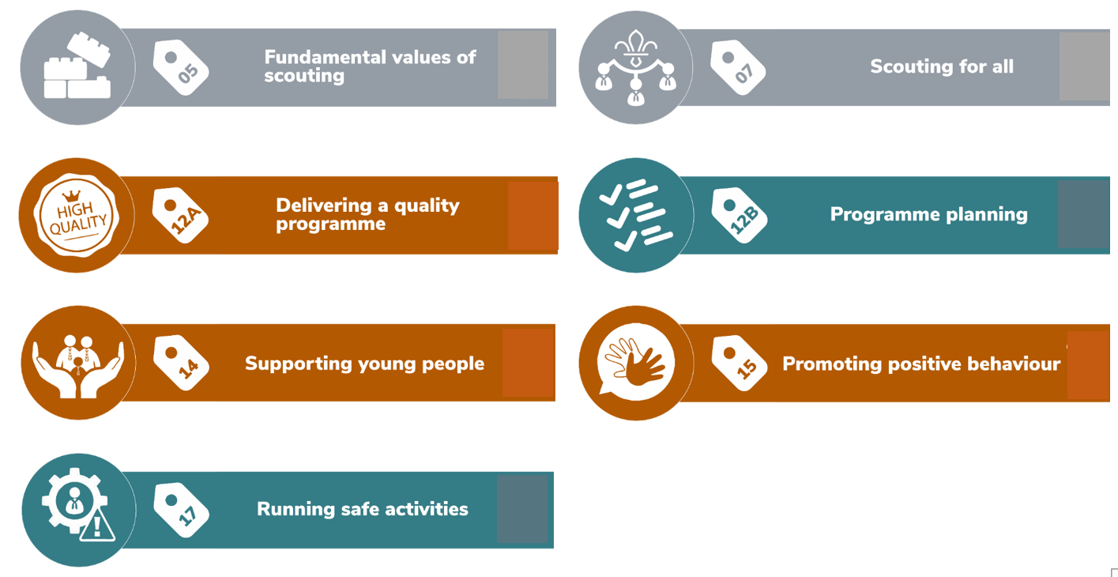

Slide 25
Section Assistants
Currently Complete:
Module 1
GDPR
Safety
Safeguarding
Modlue 3

Slide 26
Team Leader(s)
Team Member
Team Member
Team Members
Section Team
Young Leader
Team Member
Young Leader

Slide 27
Section Team Members
Will Complete:
Who we are and what we do
Data protection in scouts
Creating inclusion
Safe scouting
Delivering a great programme

Slide 28
Complete before 31st January 2024
In 2024

Slide 29
Learning Migration
Validated ‘Getting Started’ Training | Will sign off ‘Growing Roots’ Learning
GDPR Module | Data Protection in Scouts
Safety AND Safeguarding Modules | Safe Scouting
Module 1 – Essentials of Scouting | Who we are & What we do
Module 4 – Tools for the role (Managers & Supporters) | Leading Scout Volunteers
Module 3 – Tools for the role (Section Leaders) | Delivering a Great Programme
Trustee Introduction Module | Being a Trustee in Scouts
ALL getting started modules validated | Creating Inclusion

Slide 30
Recommended Learning
Everyone who have 'Growing Roots' signed off as part of the transition are recommended to complete Creating Inclusion and any relevant role / team learning
Although this is not mandatory.

Slide 31
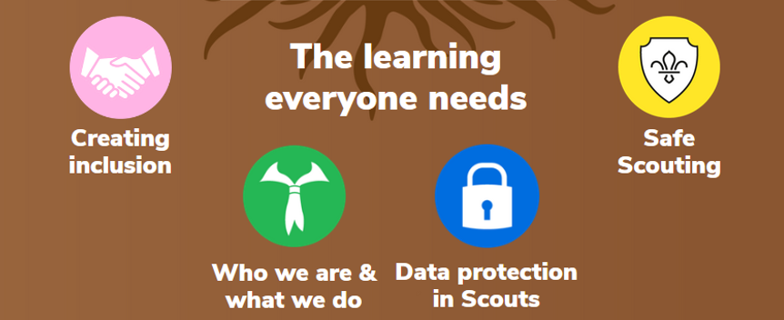
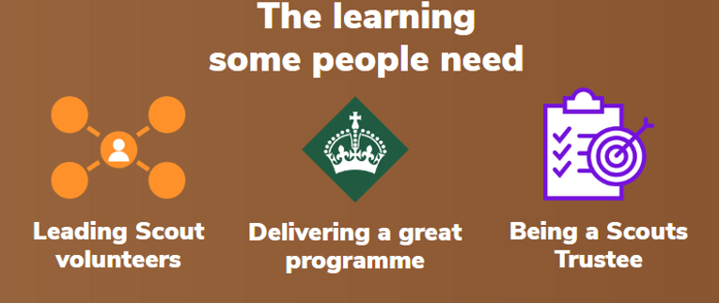
Anyone part way through…
Some ‘Getting Started’ modules validated
Complete some of the new ‘Growing Roots’
Relevant ‘Growing Roots’ complete

Slide 32
If not completed…
If not complete as Getting Started Training | Will need to complete Growing Roots Learning
GDPR | Data Protection in Scouts
Safety | Safe Scouting
Safeguarding | Safe Scouting
Module 1 – Essentials of Scouting | Who we are & What we do
Module 4 – Tools for the role (Managers & Supporters) | Leading Scout Volunteers
Module 3 – Tools for the role (Section Leaders) | Delivering a Great Programme
 | Creating Inclusion

Slide 34
Branching Out
(Optional Learning)

Slide 36
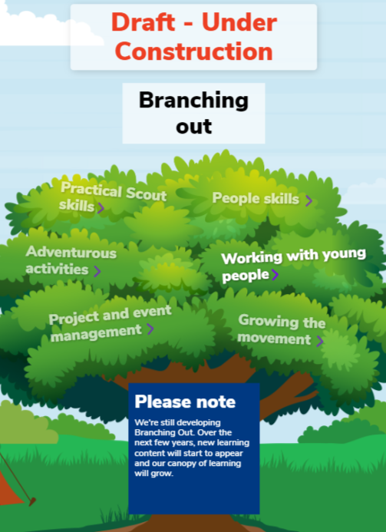

Slide 38
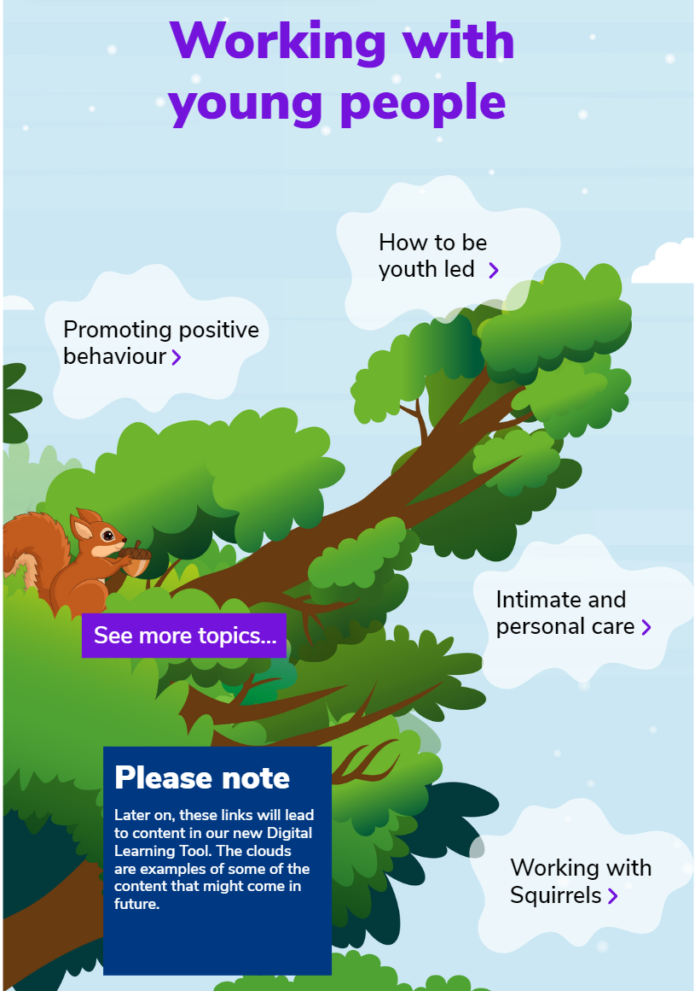

Slide 42
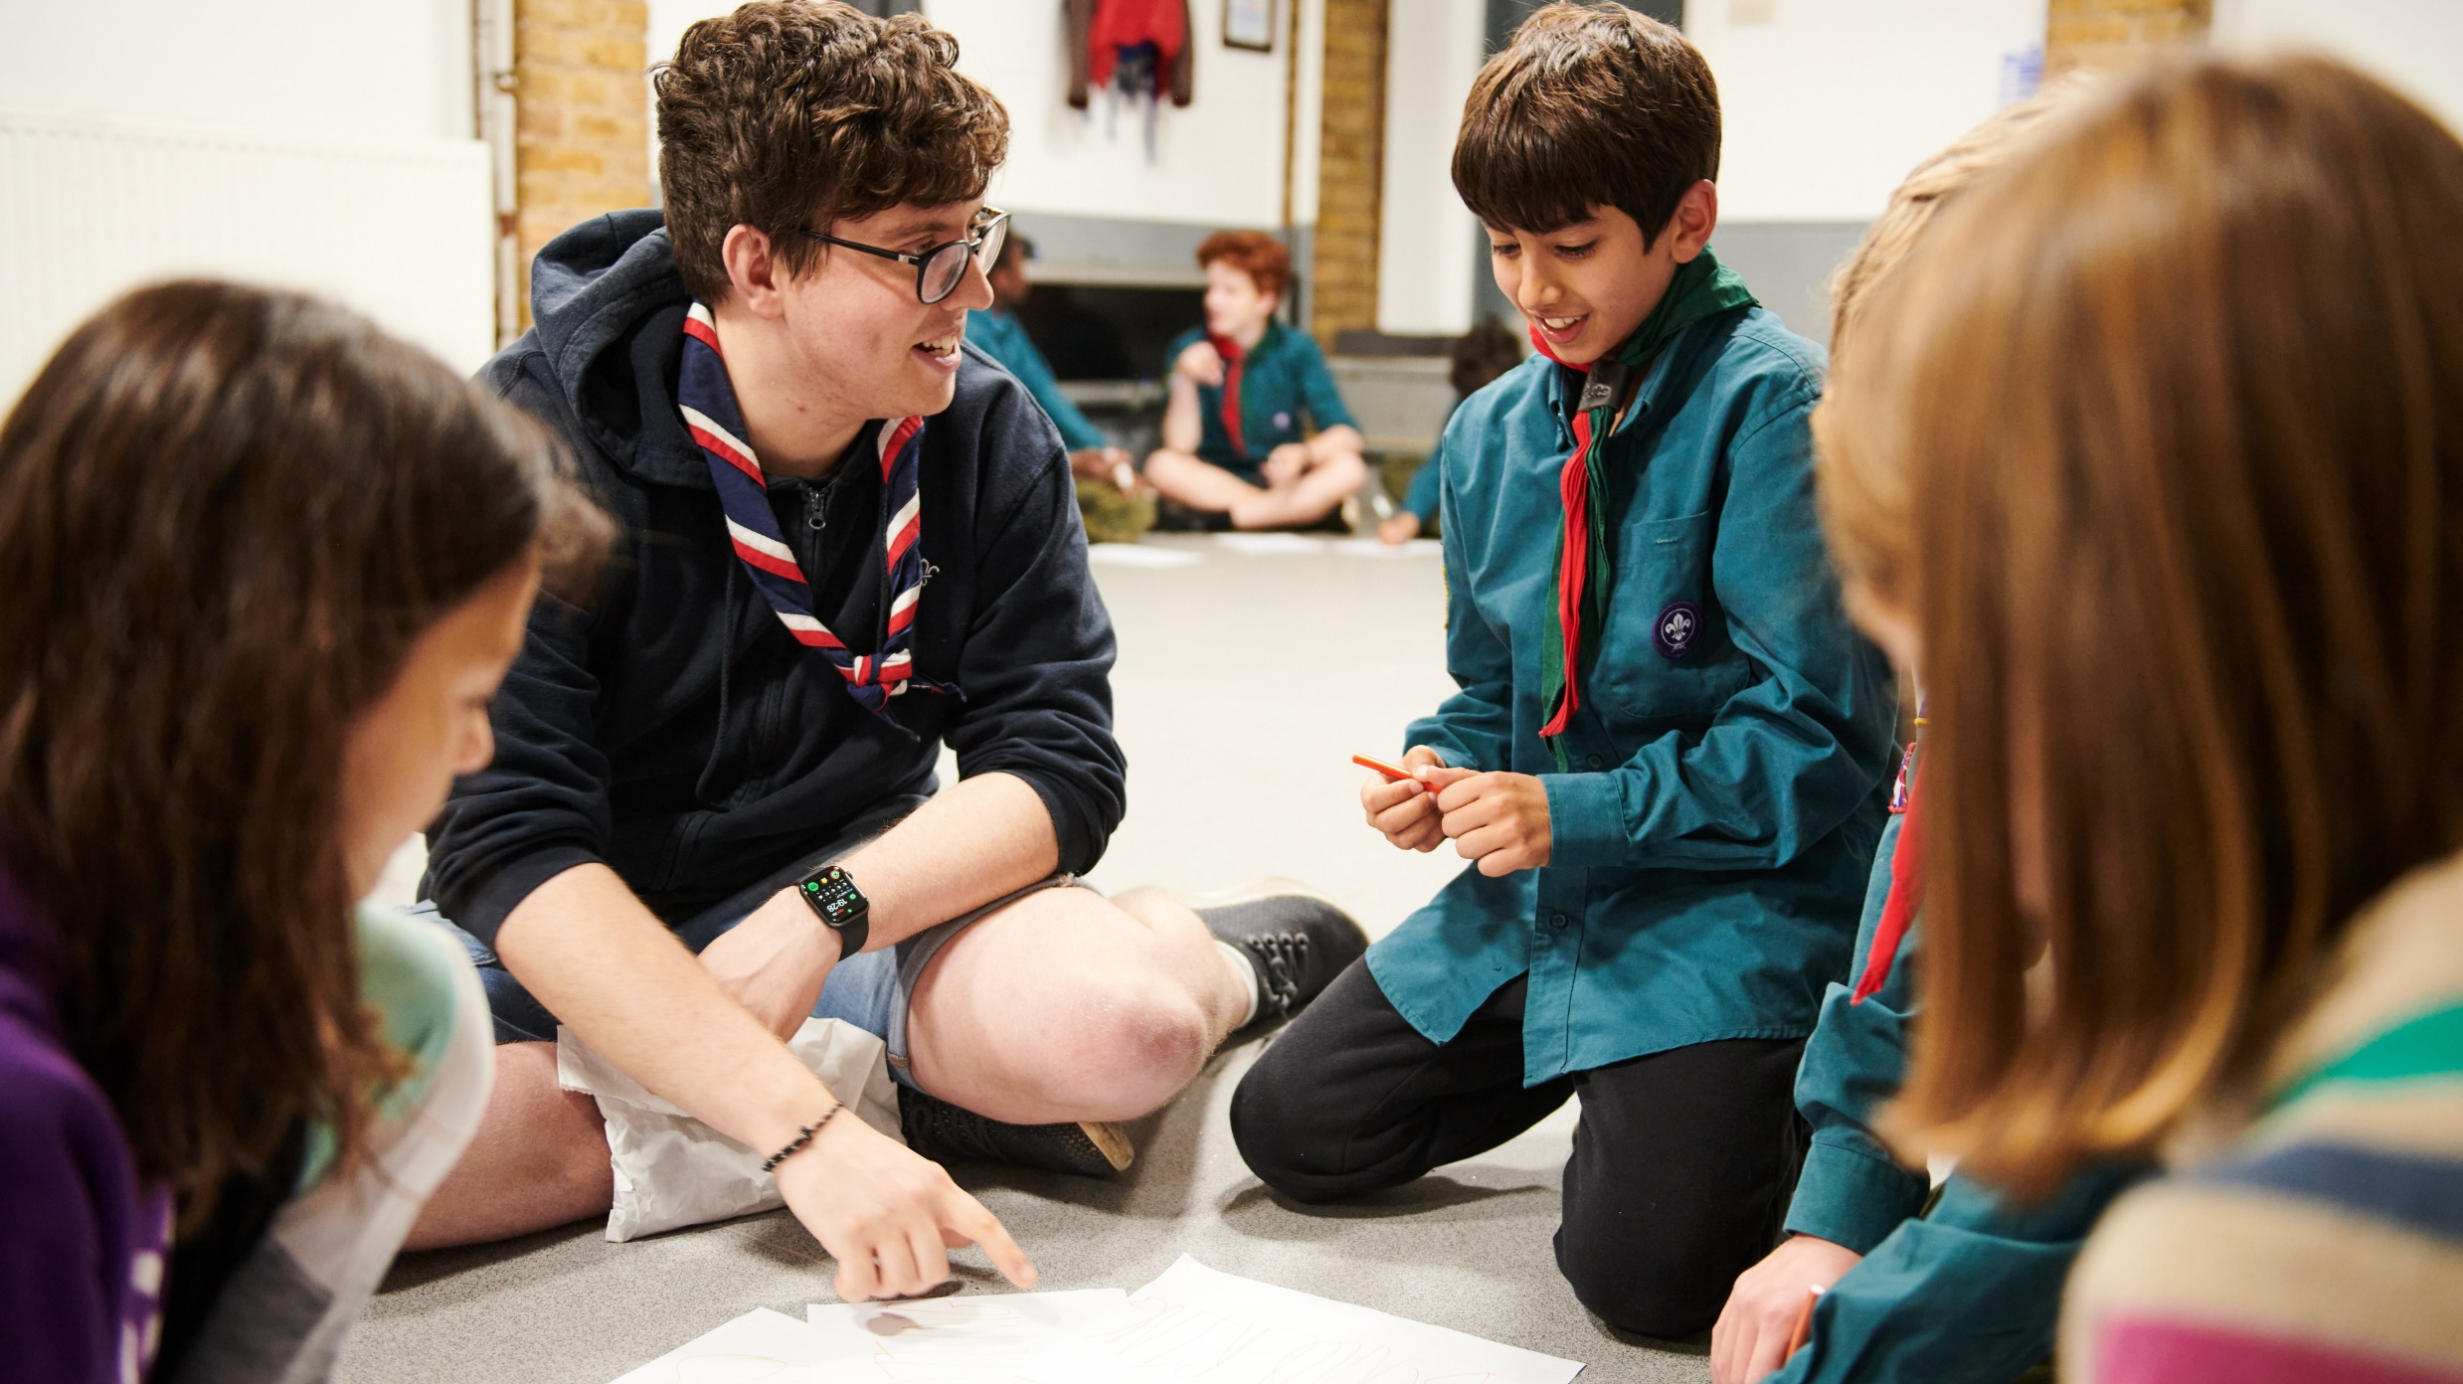
Continuing to deliver the Wood Badge into
Volunteering Development Teams will ensure that all volunteers continue to have the opportunity to complete a Wood Badge
While new learning is developed the Wood Badge will continue to be delivered using current modules and skills courses

Slide 44
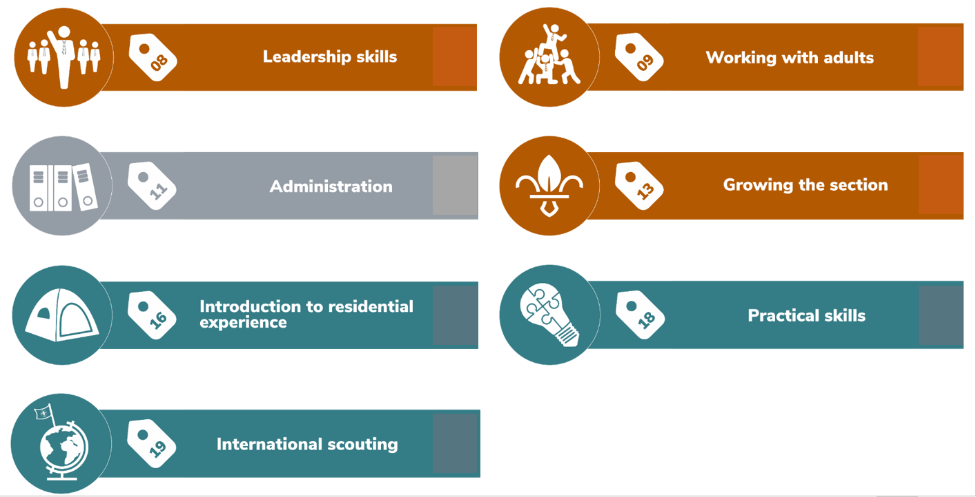

Slide 46
Programme Facing Team Members: completing their Wood Badge in 2024 into 2025

Slide 47
Team Leaders & Lead Volunteers: completing their Wood Badge in 2024 into 2025

Slide 48
Volunteers: completing their Wood Badge from early 2024 into 2025
Section Wood Badge
M&S Wood Badge
Safe Scouting (recommended)
Data Protection in Scouting (recommended)
Who we are and What we do (recommended)
Creating Inclusion*
Delivering a Great Programme*
Module 8 - Skills of leadership
Module 9 - Working with adults
Module 11 - Admin
Module 13 - Growing the section
Module 16 - Residential
Module 18 - Practical Skills
Module 19 - International
Safe Scouting(recommended)
Data Protection in Scouting (recommended)
Who we are and What we do (recommended)
Creating Inclusion*
Leading Scout Volunteers*
Module 11 - Admin
Skills of Management
Achieving Growth
Meeting the challenge
*Any volunteers who have been signed off during transition as having completed Growing Roots will be required to complete this new learning

Slide 49
If not completed…
If not complete as Getting Started Training | Will need to complete Growing Roots Learning
GDPR | Data Protection in Scouts
Safety | Safe Scouting
Safeguarding | Safe Scouting
Module 1 – Essentials of Scouting | Who we are & What we do
Module 4 – Tools for the role (Managers & Supporters) | Leading Scout Volunteers
Module 3 – Tools for the role (Section Leaders) | Delivering a Great Programme

Slide 50
Programme Facing Team Members: completing their Wood Badge in 2024 into 2025

Slide 51
Team Leaders & Lead Volunteers: completing their Wood Badge in 2024 into 2025

Slide 52
Volunteers: completing their Wood Badge in 2024 into 2025
Section Wood Badge
M&S Wood Badge
Growing Roots
Module 8 - Skills of leadership
Module 9 - Working with adults
Module 11 - Admin
Module 13 - Growing the section
Module 16 - Residential
Module 18 - Practical Skills
Module 19 - International
Module 10 - First Aid
Growing Roots
Module 11 - Admin
Skills of leadership
Achieving growth
Managing challenges

Slide 53
Programme Facing Team Members: completing their Wood Badge from 2025

Slide 54
Team Leaders & Lead Volunteers: completing their Wood Badge from 2025

Slide 55
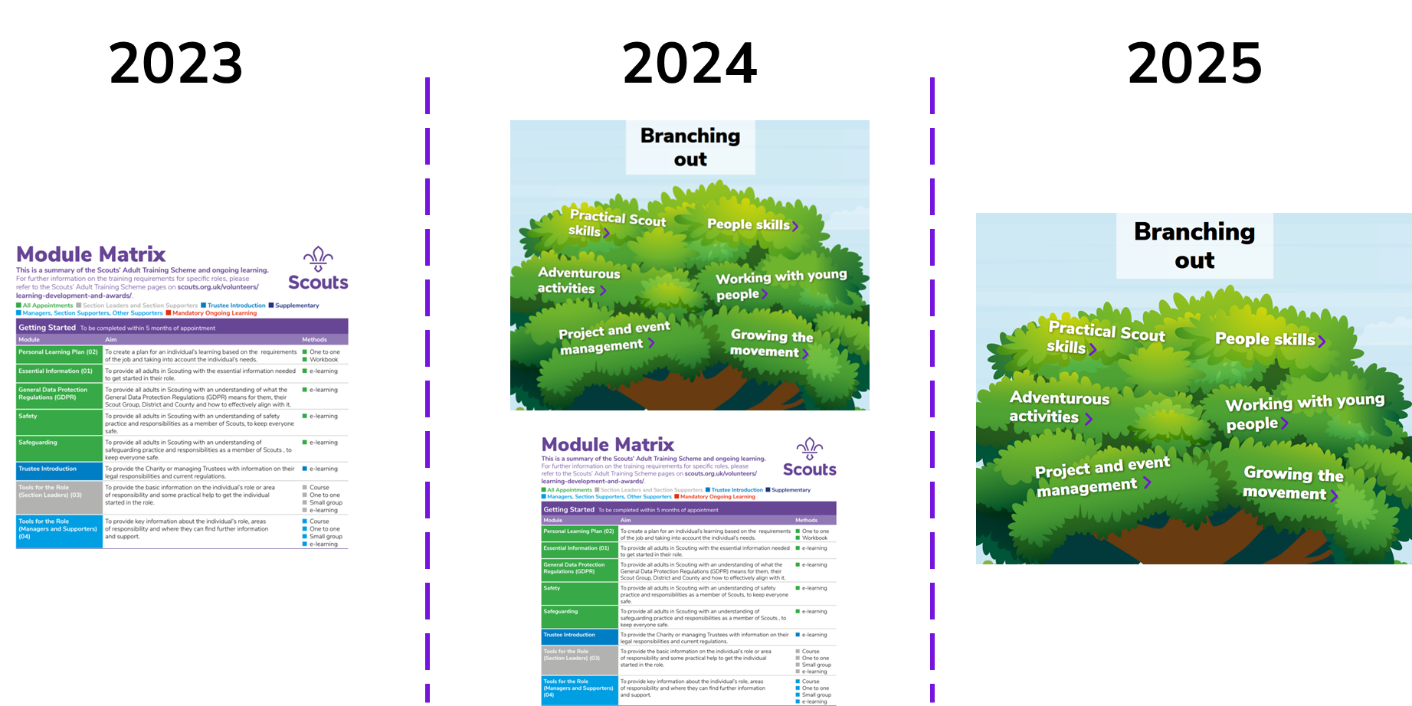
What will branching out look like?
Continue with existing scheme
Mix of new and old
New branching out

Slide 58
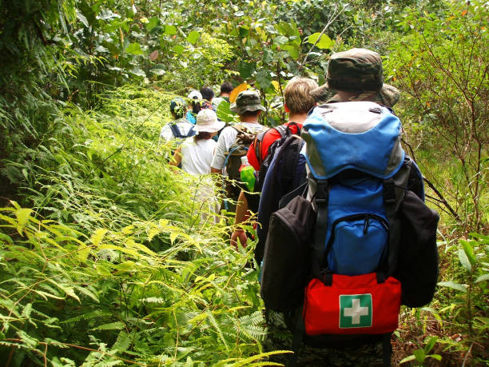
As part of the move to the team-based approach, a review of who requires a First Aid qualification was undertaken and the following principles agreed:
First Aid Principles

Slide 59
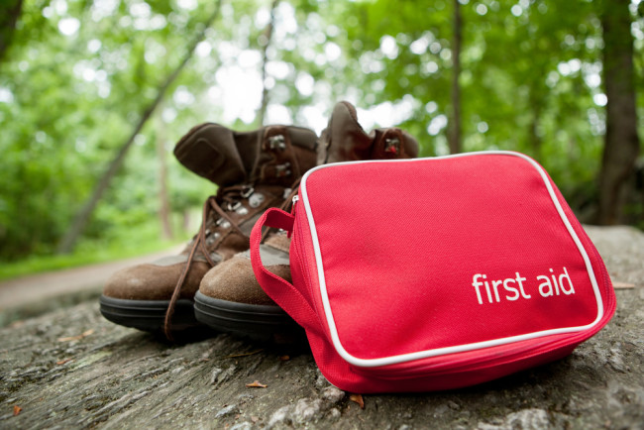
Every young person should have direct access to first aid treatment when on Scout activities
Parents and carers should be confident that every adult leader, who is regularly and directly involved with their child’s Scouting, has completed, or is working towards completing, first aid training
No young person should ever miss out on a Scouts activity due to a lack of qualified adult first aid cover
Having a body of first aid trained volunteers has a positive impact on our communities

Slide 60
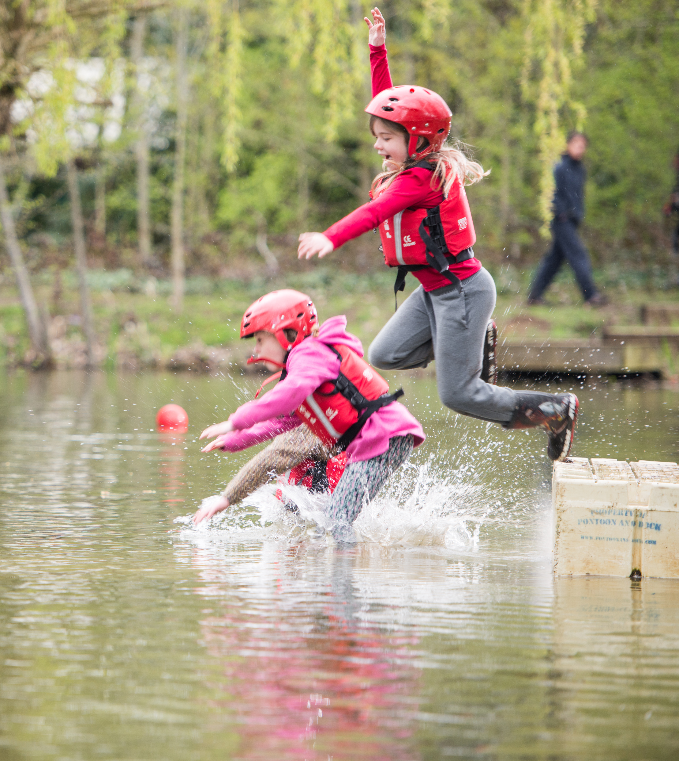
First Aid
This is the current proposal for First Aid
in the final stages of approval
First Aid is required for roles which:
Work directly with young people on a regular basis; or
Might reasonably be required to step in and work directly with young people
This includes the following roles:
All Section Team Leaders & Members (Squirrels, Beavers, Cubs, Scouts, Explorers)
Group Lead Volunteers
14-24 Team Leaders
This also means several leadership roles will no longer be required to have first aid

Slide 61
Section Assistants

Slide 62
Team Leader(s)
Team Member
Team Member
Team Members
Section Team
Young Leader
Team Member
Young Leader

Slide 63
All Team Members

Slide 64
Make your current Section Assistants aware that they will be required to complete First Aid (First Response)

Slide 65
Timeframes
Volunteers who transition into a role/team requiring first aid will have at least 2 years from transition to complete this
More details on the transition timings for first aid will be shared after approval

Slide 66
Timeframes
New volunteers joining a team that requires first aid after the transition will have 1 year to complete it
More details on the transition timings for first aid will be shared after approval

Slide 67
No change to the syllabus

Slide 68
First Response delivery models
Face to Face
Theory and Practical Demo
1 x 6-hour F2F session
OR
3 x 2-hour F2F sessions
Online
Theory
Practical Demo
3 x 2-hour online
trainer-led sessions
1 x 20-minute practical F2F
Blended
Theory
Practical Demo
1 x 2.5-hour
E-Learning
THEN
1 x 3-hour online trainer-led session
1 x 20-minute practical F2F

Slide 71
Safe Scouting
Every 3 years
(Current Compass renewal dates will migrate across)

Slide 72
When learning will need to complete (when going roots learning goes live)
All Adults | Within the first 6-months | Within the first 6-months & every 3 years | Within the first year & every 3 years
 | Creating Inclusion | Safe Scouting | First Aid (If applicable)
 | Data Protection in Scouts
 | Who we are and What we do
As relevant to role/team | Delivering a great programme
 | Being a Trustee in Scouts
 | Leading Scout Volunteers

Slide 73
Simplified roles and structures

Slide 74
As:
completing a Wood Badge is becoming optional
learning plans and pathways will be part of our new online learning system
there will be simpler requirements and minimal manual validation of learning

Slide 75
The Training Advisor role, and our current training support structure is being discontinued.
In its place each district/county will have a new Volunteer Development Team.

Slide 76
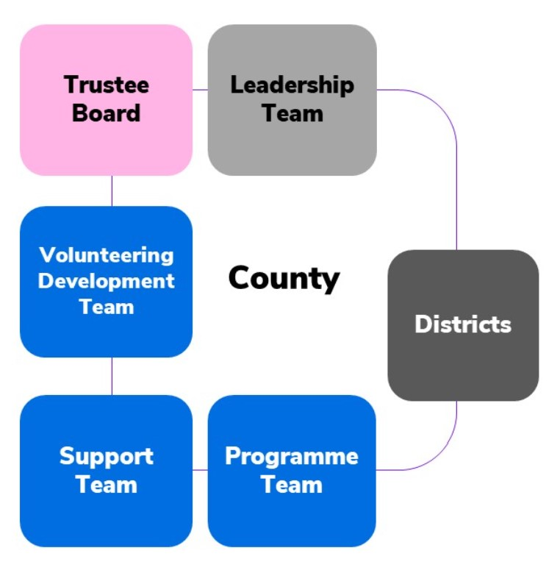
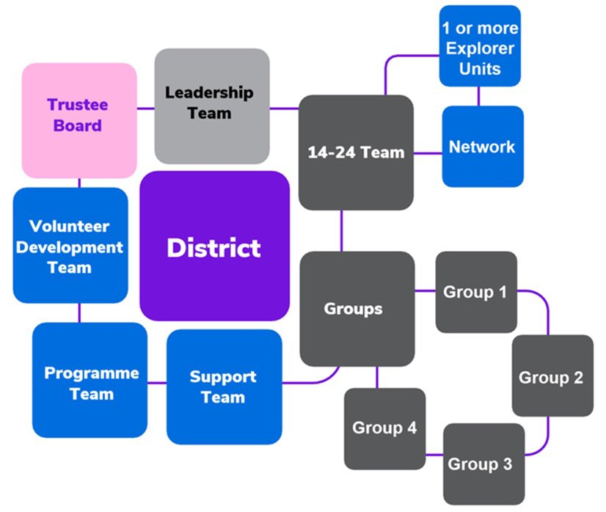
County

Slide 77
The purpose of the team is to ensure all volunteers within the district have a positive volunteering experience and are supported throughout their time as an adult in scouting.
This covers supporting the:
welcome and induction
appointment and screening
learning and development
review
recognition
of volunteers across the district.

Slide 78
Training
Advisers
Volunteer Development Team Members

Slide 79
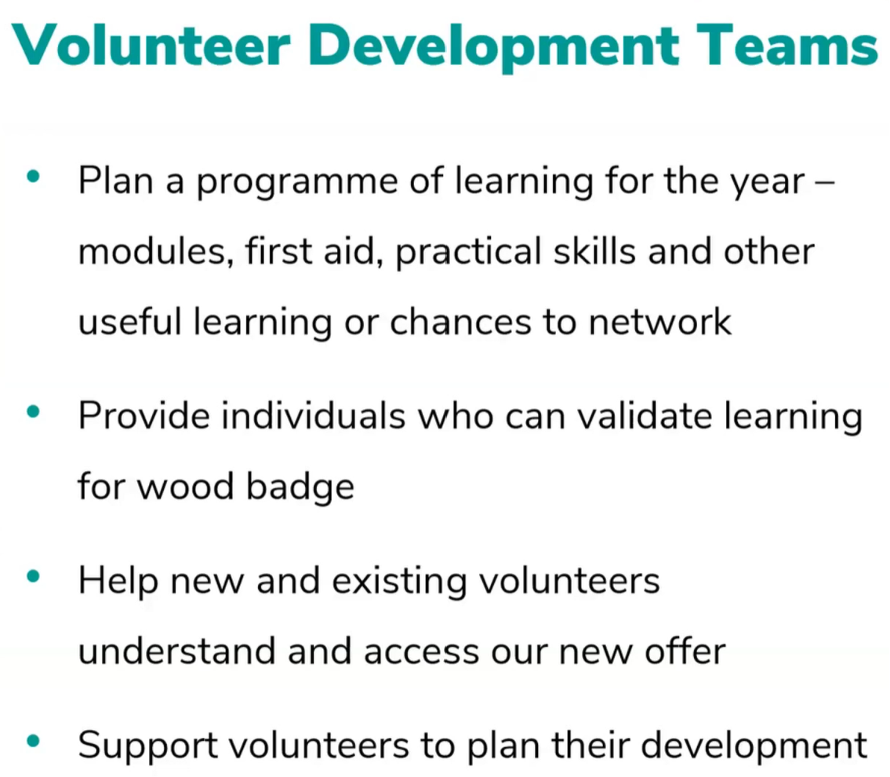

Slide 82
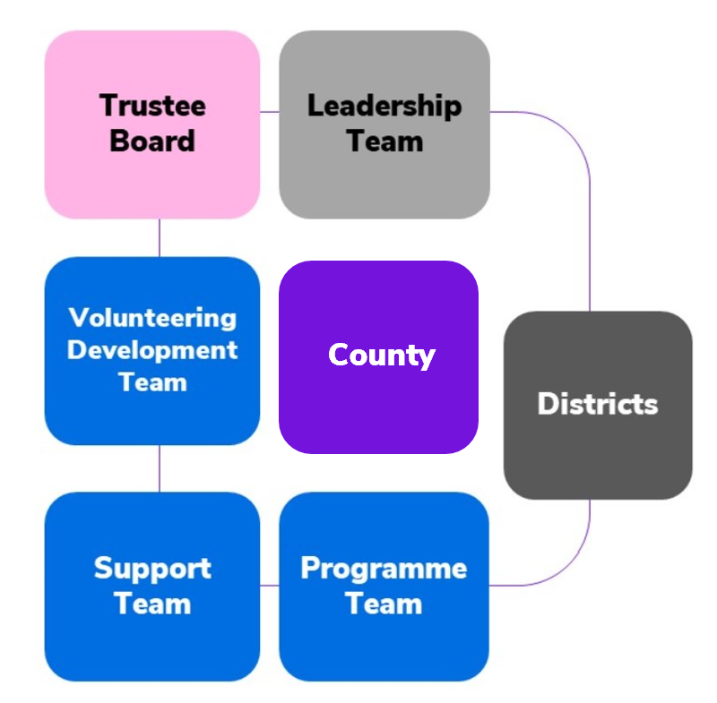
Volunteering Development Teams

Slide 83
Volunteering Development Teams

Slide 84
Volunteering Development Teams

Slide 86
Volunteering Development Teams
=

Slide 87
Volunteering Development Teams
=
=

Slide 88
Accreditations for tasks & responsibilities
For some tasks and responsibilities, we need to make sure people have the right skills, experience, learning or qualifications.

Slide 89
Accreditations
A way to share out tasks in a team (accreditations are not a role)
Lead volunteers share out responsibilities and tasks
To take on more tasks doesn’t require a new role, but simply more accreditations
Need to be a full member
Granted by the lead volunteer/team leader, following completion of the relevant learning
They will expire after a period of time

Slide 90
Accreditations
Nights Away
Welcome Conversation Volunteer
Nights Away Assessor
Adventurous Activity Assessor
Award Nominations Supporter
Data Lead
Suspension Lead
Nights Away Approver
Permit Approver
Resolution Lead
Volunteer Safeguarding Lead
Learning assessor (during the transition
period up to 2025)
Award Nominations Supporter
DBS Processing

Slide 91
Learning management system

Slide 92
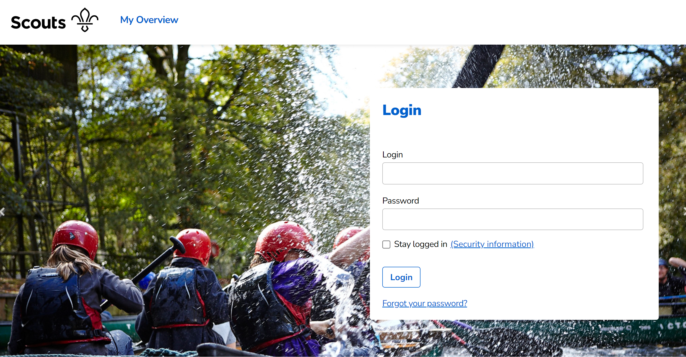

Slide 93
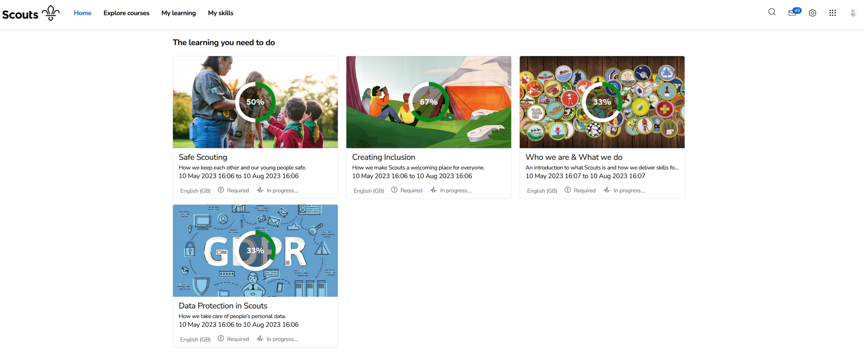

Slide 94
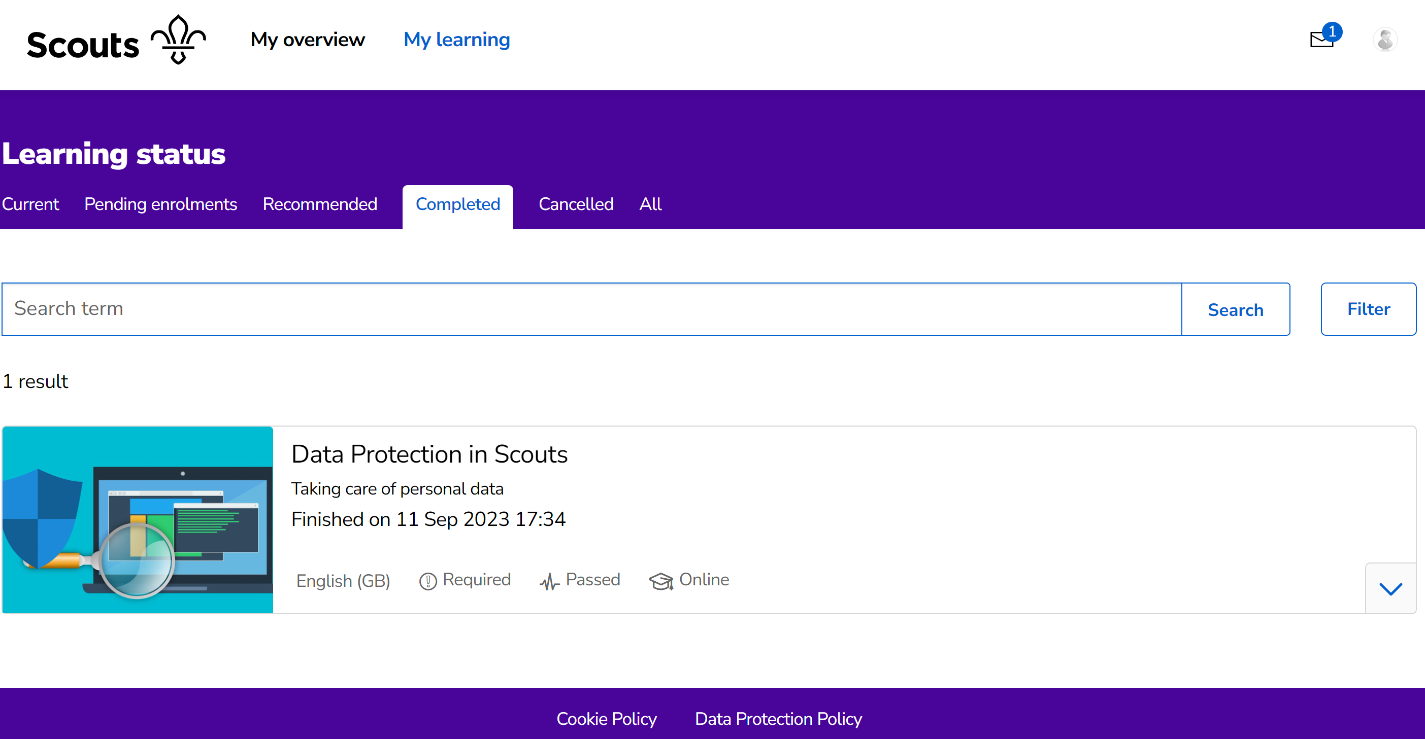

Slide 95
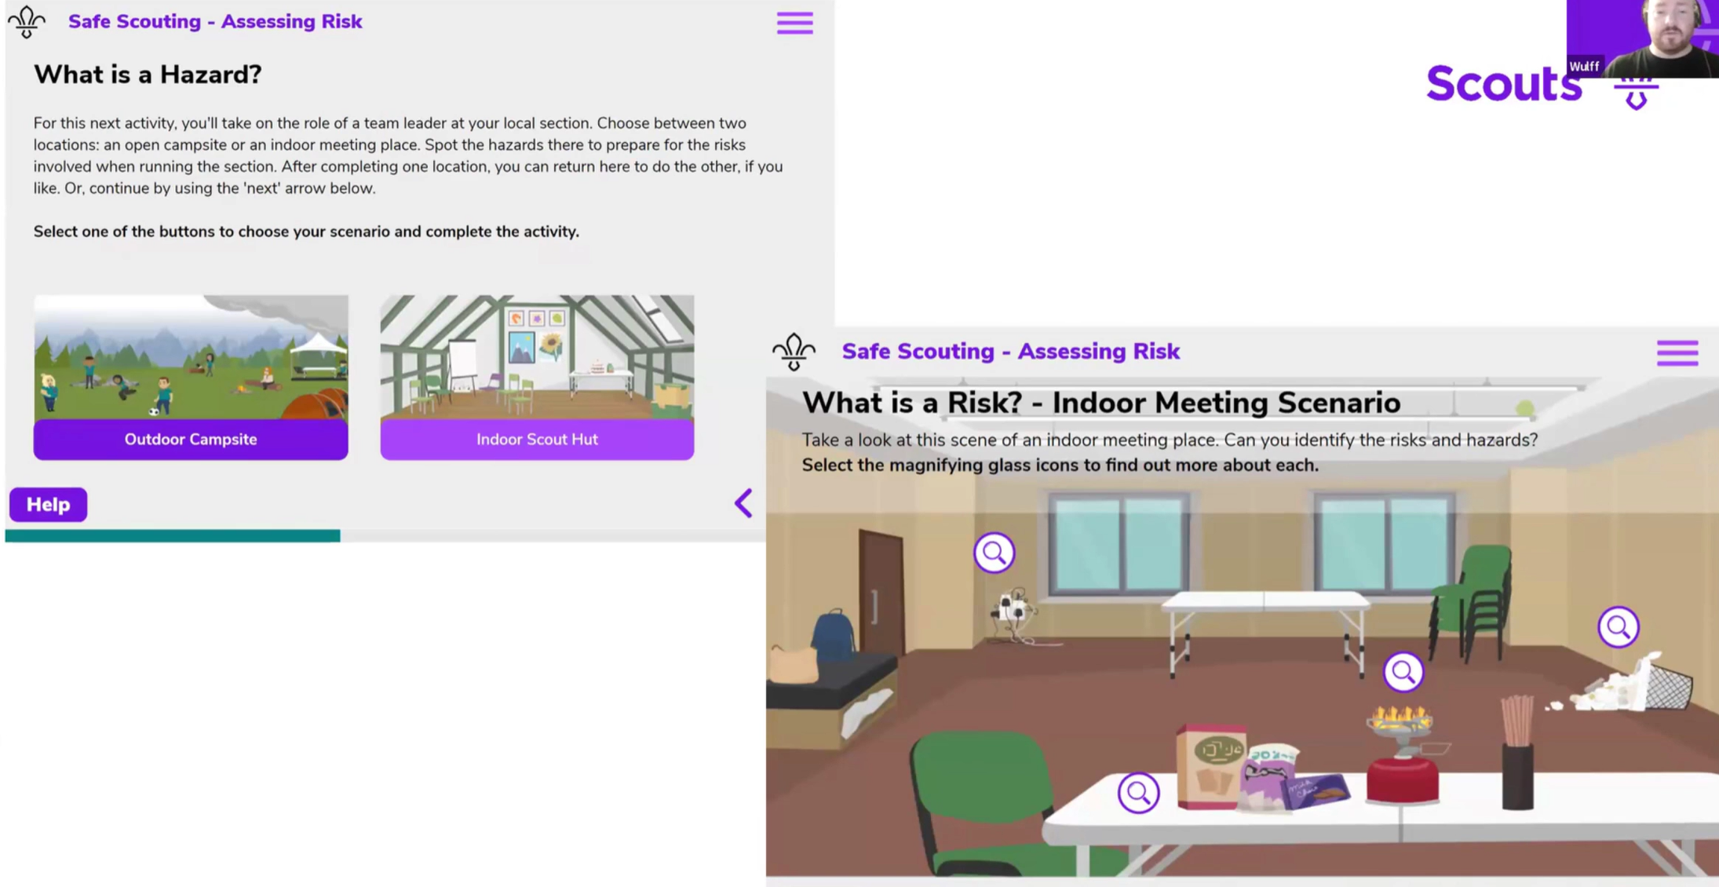

Slide 96
Learning data migration

Slide 98
Learning Data Migration
Members who have validated all their ‘Getting Started’ modules will be automatically signed off as having completed ‘Growing Roots’

Slide 99
Learning Data Migration
Ensure all completed training is validated on compass
All unvalidated training will not be migrated

Slide 100
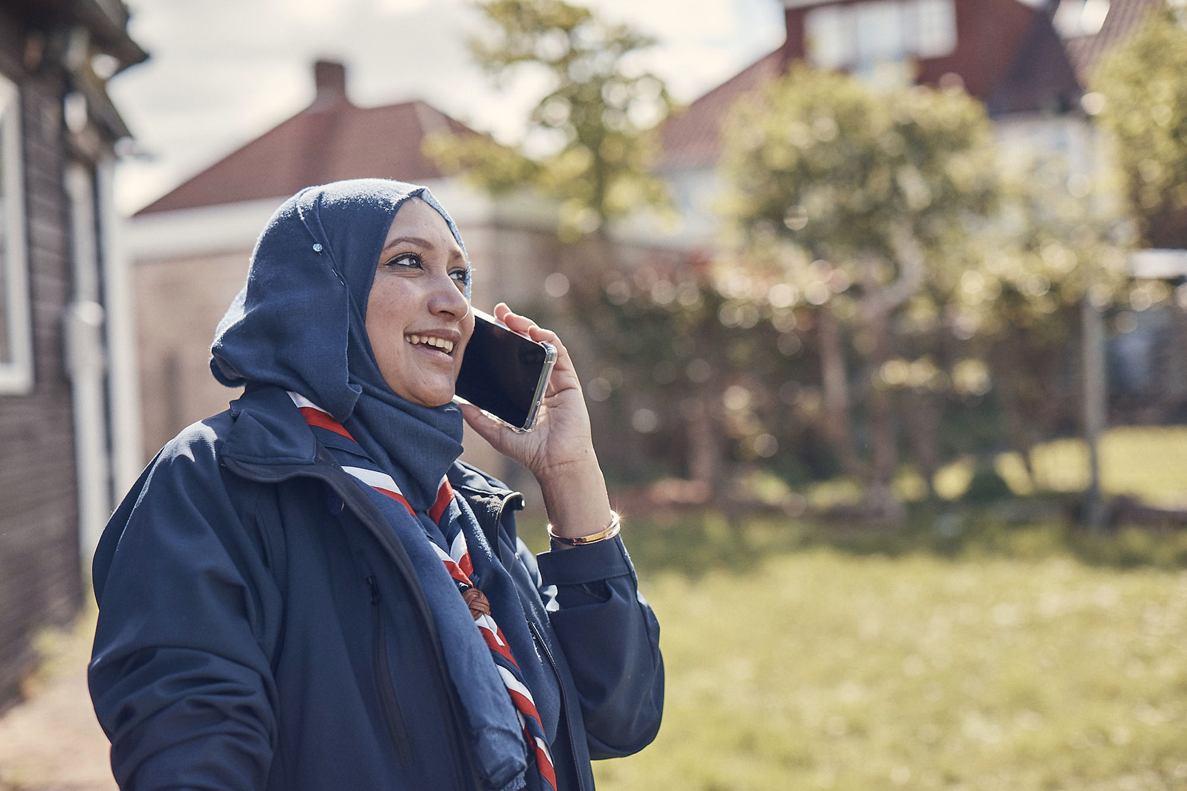
Learning Data Migration
Remember…
Members who have validated some of their ‘Getting Started’ modules will be required to complete any outstanding learning through the new Growing Roots learning

Slide 102
Three things we need to be really clear on:
We will not be jumping from the current system to the new ‘overnight’. There will be a phased approach
If you are up to date with your learning, you won’t need to do more
If you hold a Wood Badge it will still be valid

Slide 103
What will change on day 1?
New learning experience system
New Growing Roots learning which replaces Getting Started and some of the modules within our current scheme
Wood Badge becomes optional
All modular learning that isn't core learning begins to count towards credits for the learners Wood Badge

Slide 104
What will change on day 1?
Training teams will become Volunteer Development Teams
Volunteer Development Teams supporting volunteers to access Growing Roots learning and complete mandatory first aid training

Slide 105
What will NOT change on day 1?
All modular learning which isn't covered by core learning will be delivered in the same way as part of Branching Out learning
Volunteer development teams will continue to support delivery of modular learning
Manager and Supporter training will continue (unit 2026)
Trustee induction learning (where run) will continue

Slide 106
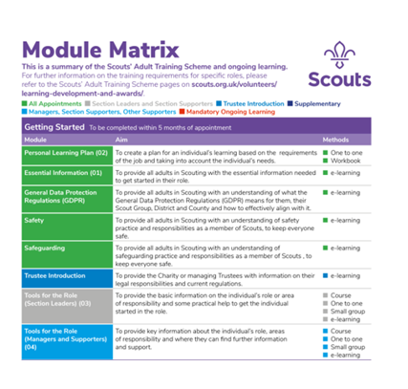
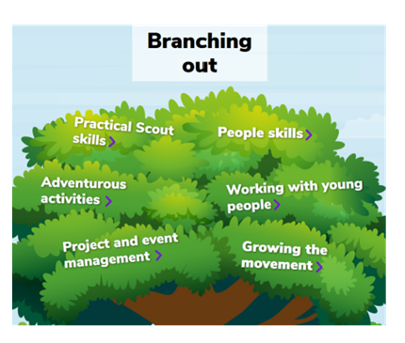
In 2024 & 2025
As new Branching out learning, for section teams, is rolled out and added to the new learning system, the relevant current modules will be removed, gradually reducing the opportunities to complete learning using the current scheme and increasing the opportunities to complete learning using the new Branching Out learning

Slide 107
In 2024 & 2025
New Branching Out learning will be a mixture of more digital but also face to face content
New Wood Badge programme will be fully launched

Slide 109
Steps to take now…
Talk your team through the changes and the impact of the changes for them.
Ensure that your current Section Assistants are aware!

Slide 110
Steps to take now…
Ensure all your team members (including trustees), have completed and validated their ‘Getting Started’ training modules no later than 31st December 2023.
(Current training managers have access to the reports for this)

Slide 111
Steps to take now…
Encourage and support your team members to complete their Wood Badges.

Slide 112
Steps to take now…
Begin to identify people who may need to complete relevant accreditations, e.g. Welcome Conversation- ahead of transition

Slide 113
Please ensure all completed training is validated by 1st February 2024. All unvalidated training will not be migrated
Please ensure ALL completed training is validated on
Compass.
Training that is not validated will not be migrated and will need to be completed again.

Slide 115
These changes will help us to make sure that:
every volunteer is welcomed
every volunteer is supported
every volunteer is valued
every volunteer gains skills (and has a good time!)
every volunteer matters

Slide 117
tinyurl.com/vol-journey

